Slide 1
Module 1: Introduction to Single Cell RNA-Seq
NC State scRNA Workshop, 2024

Slide 2
Outline
Advances and Popularity
Questions and Applications
scRNA-Seq Experiment Workflow
scRNA-Seq Technologies
scRNA-Seq Computational Workflow
Atlas Datasets

Slide 3
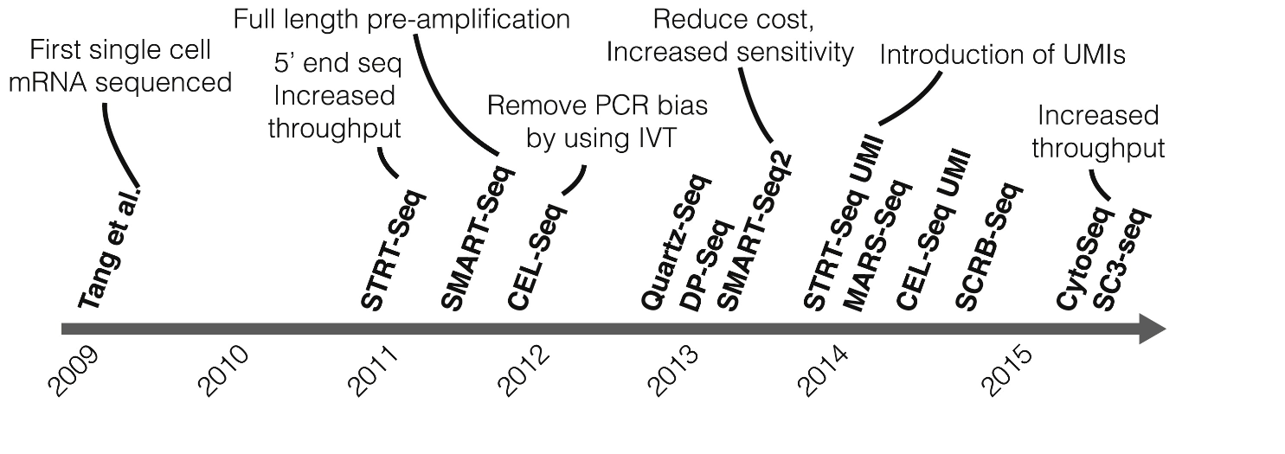
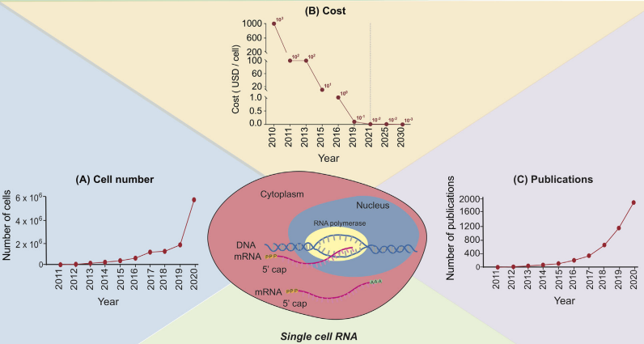
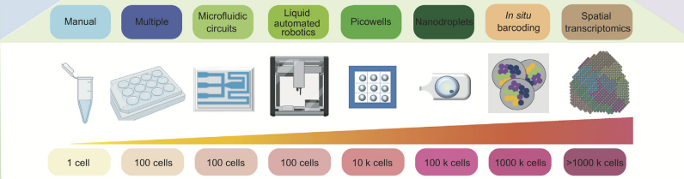
Rapid Rise of Single Cell RNA-Seq in Research
Kolodzeijczyk. Mol. Cell (2021). 58:4 P610-620.
Jovic. Clin Transl Med. 2022 Mar; 12(3): e694.
Notes:
https://www.ncbi.nlm.nih.gov/pmc/articles/PMC8964935/

Slide 4
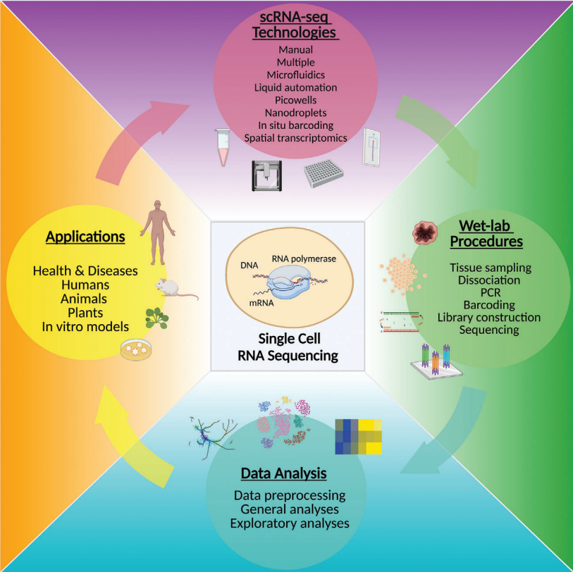
scRNA-Seq Research Lifecycle
Jovic. Clin Transl Med. 2022 Mar; 12(3): e694.
Notes:
https://www.ncbi.nlm.nih.gov/pmc/articles/PMC8964935/

Slide 5
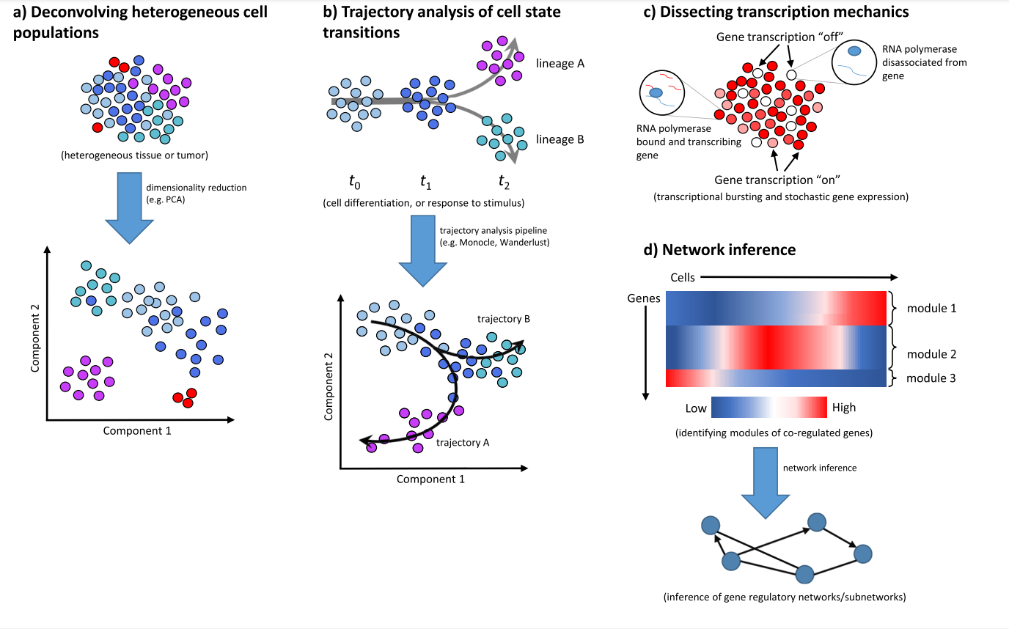
Applications of Single Cell RNA-Seq
Liu, 2016; 5: F1000 Faculty Rev-182.c
Notes:
https://www.ncbi.nlm.nih.gov/pmc/articles/PMC4758375/

Slide 6
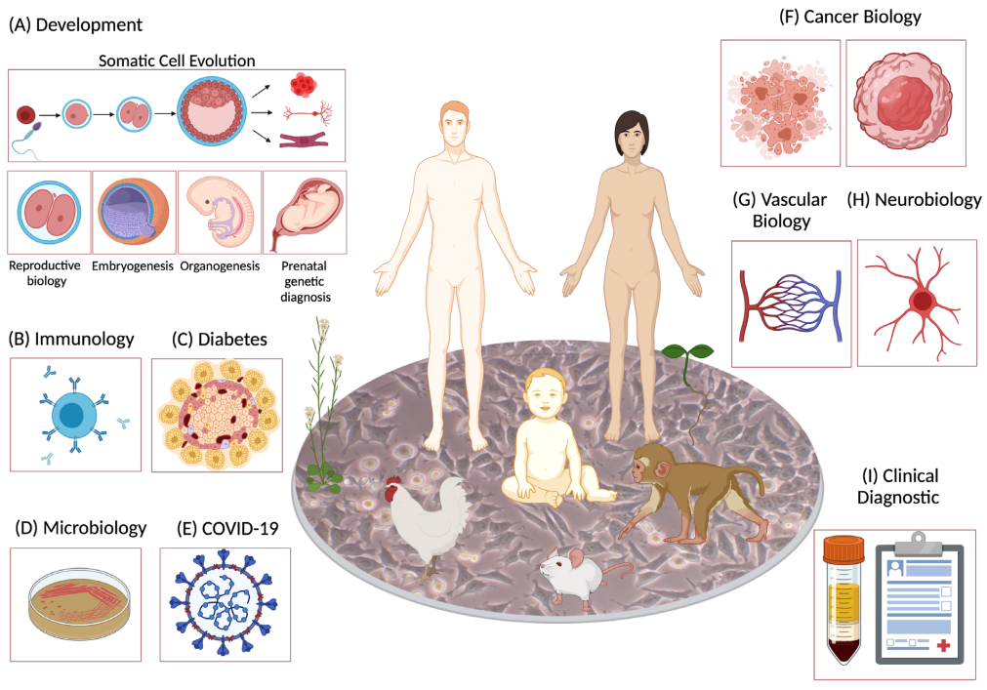
Applications of Single Cell RNA-Seq
Liu, 2016; 5: F1000 Faculty Rev-182.c
Notes:
https://www.ncbi.nlm.nih.gov/pmc/articles/PMC4758375/

Slide 7
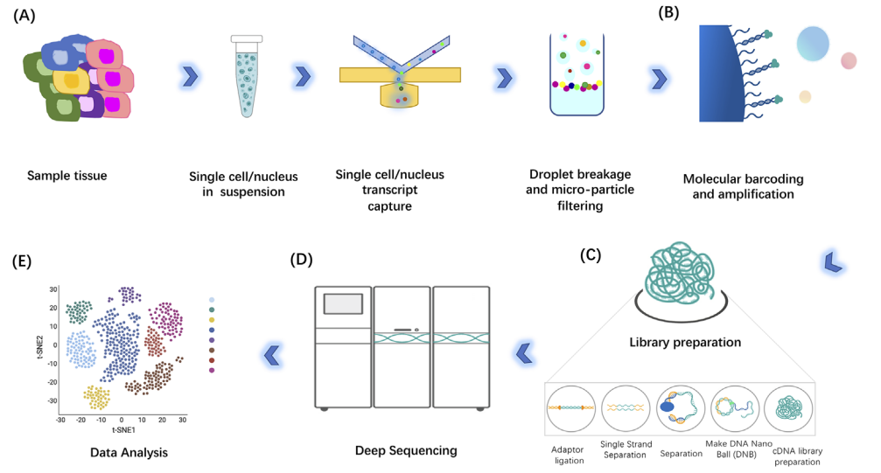
Basic single cell RNA-Seq Workflow
Liu, 2016; 5: F1000 Faculty Rev-182.
Notes:
https://www.ncbi.nlm.nih.gov/pmc/articles/PMC4758375/

Slide 8
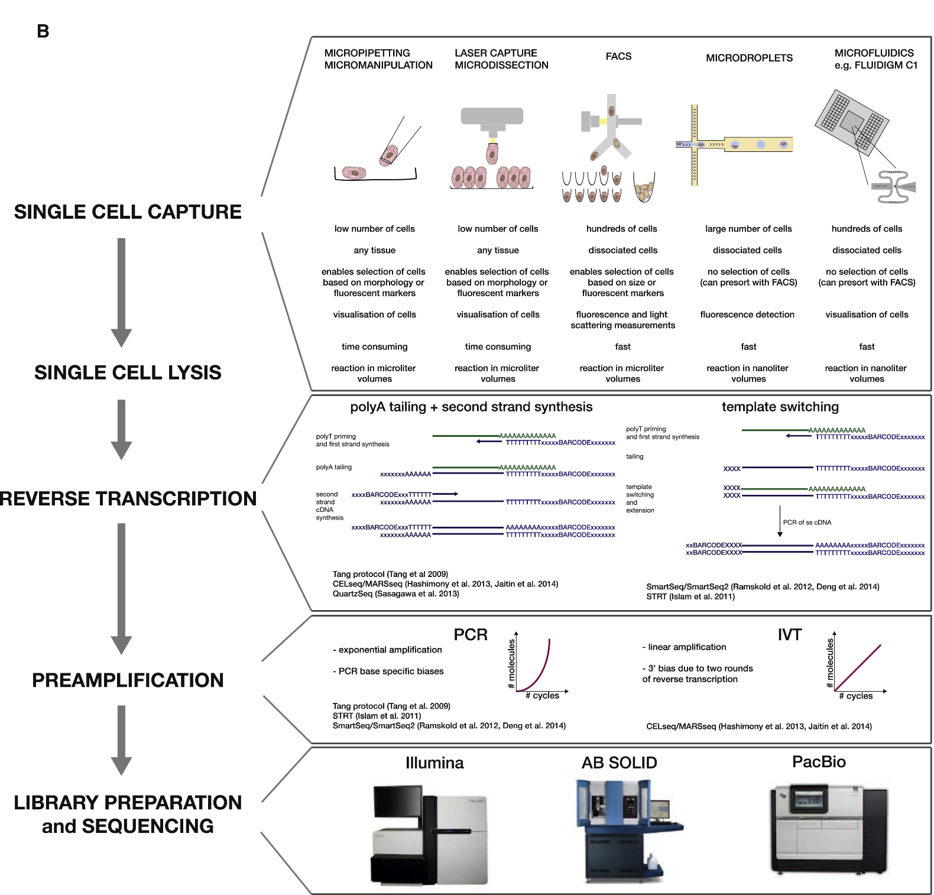
scRNA-Seq Technologies
Liu, 2016; 5: F1000 Faculty Rev-182.c
Notes:
https://doi.org/10.1016/j.molcel.2015.04.005

Slide 9
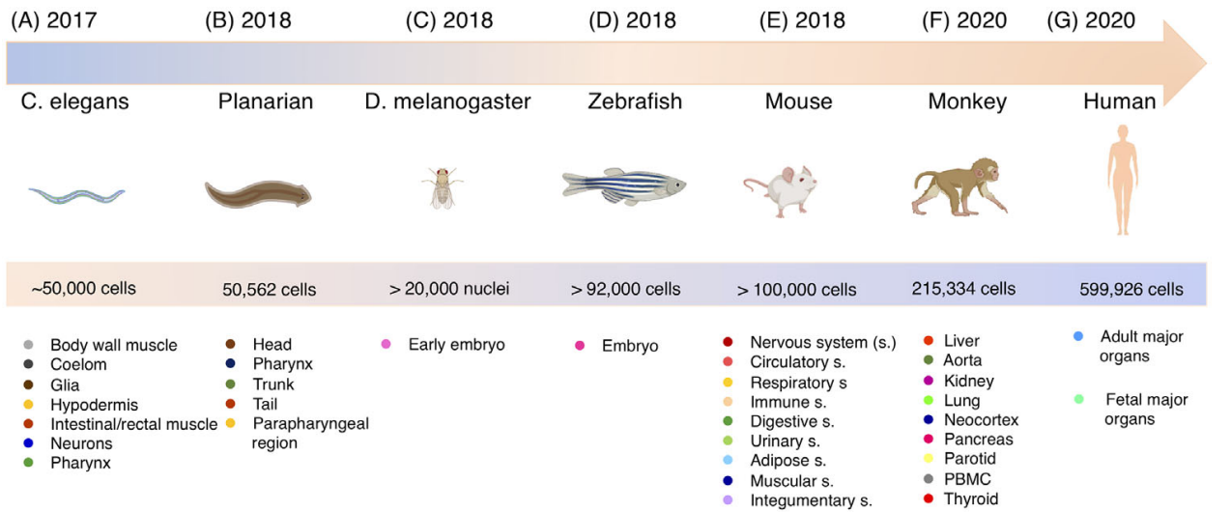
Continuous Development of Larger Atlas Datasets
Liu, 2016; 5: F1000 Faculty Rev-182.
Notes:
https://www.ncbi.nlm.nih.gov/pmc/articles/PMC4758375/

Slide 10
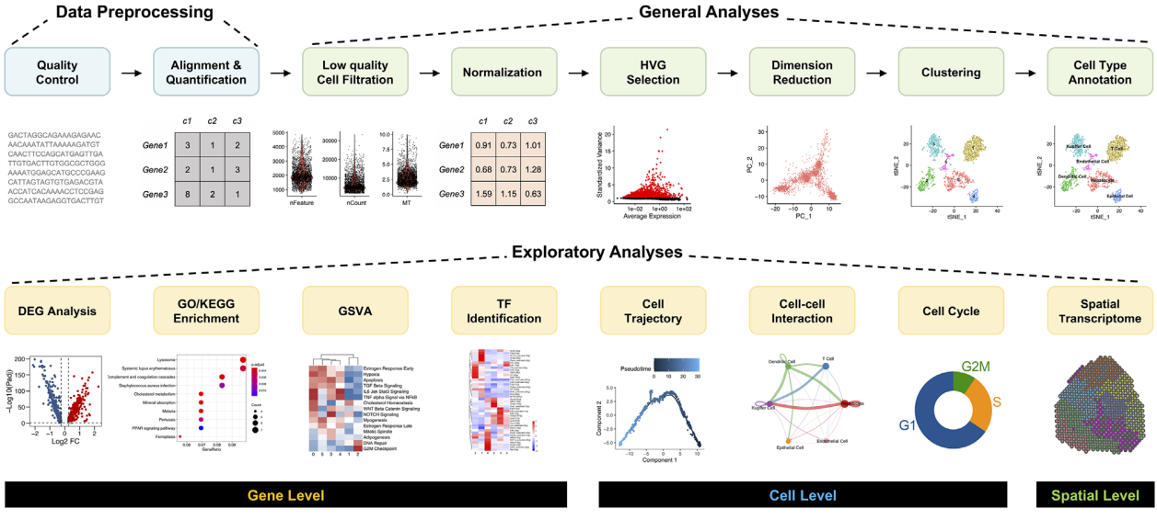
scRNA-Seq Workflow
Liu, 2016; 5: F1000 Faculty Rev-182.c
Notes:
https://www.ncbi.nlm.nih.gov/pmc/articles/PMC4758375/

Slide 11
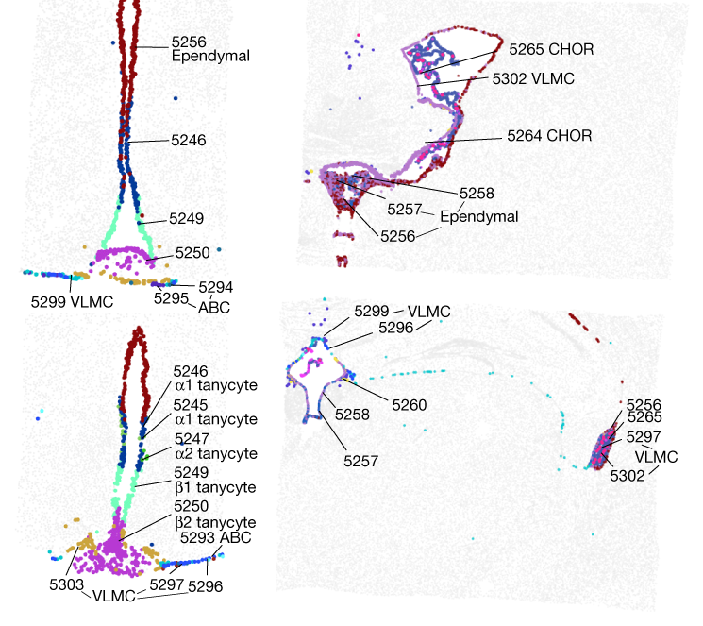
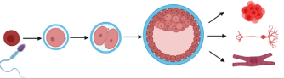
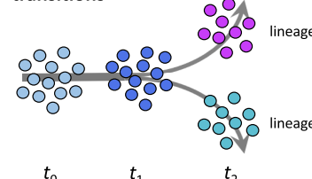
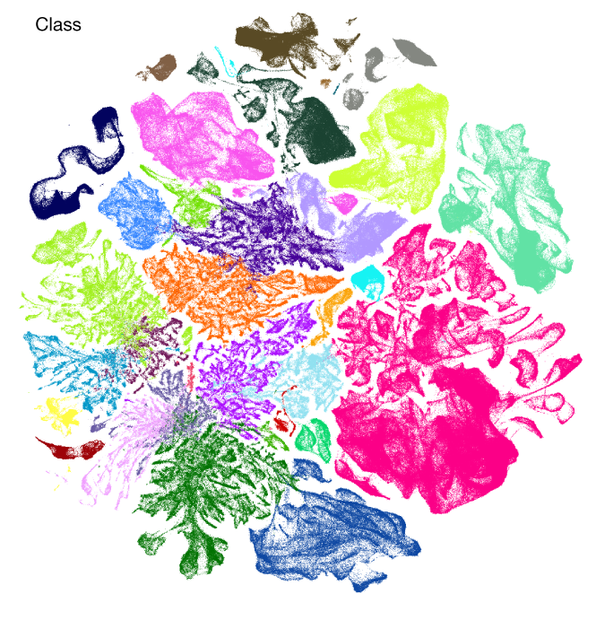
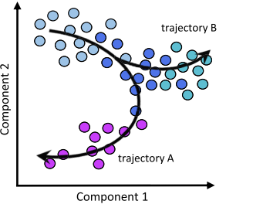
Questions?
Advances and Popularity
Questions and Applications
scRNA-Seq Experiment Workflow
scRNA-Seq Technologies
scRNA-Seq Computational Workflow
Atlas Datasets
Yao. Nature: (2023) 624, 317–33.

Slide 12



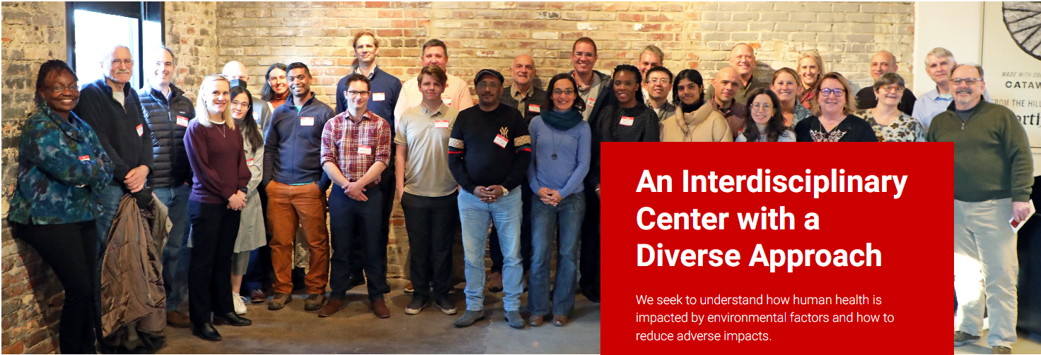
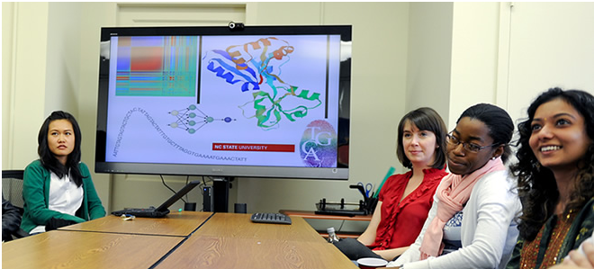
Bridging biological research and data science for the next generation of scientific discoveries.

